Slide 1


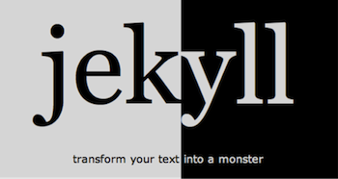

Jekyll
Static Site Generator
Template-Based Site Generation
Svetlin Nakov
Technical Trainer
www.nakov.com
Software University
http://softuni.bg

Slide 2

Table of Contents
What is Jekyll
Installing Jekyll
Jekyll in Action

Slide 3
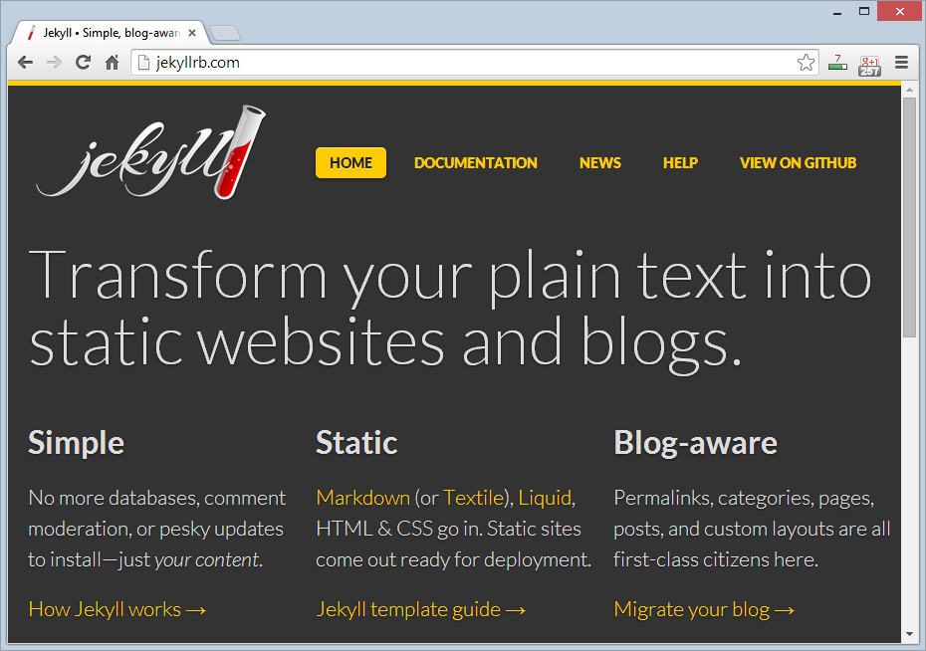
What is Jekyll?

Slide 4
What is Jekyll?
Jekyll is a simple, blog-aware, static site generator
Generates a Web site by predefined templates
Layout / design templates (page layout, header, footer, sidebar, etc.)
Content template (pages content, posts content)
Used by front-end developers for building static sites
E.g. to demonstrate their site / front-end in action
Open-source project in GitHub, Ruby-based
Official site: http://jekyllrb.com

Slide 5
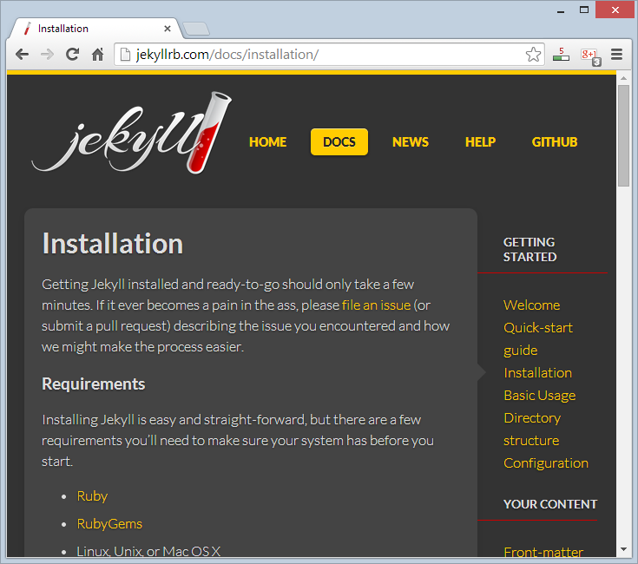
Installing Jekyll

Slide 6
Installing Jekyll
Installing Jekyll is really a pain!
Install Ruby
Install & configure DevKit
Install Jekyll
Install Python
Fix pygments.rb
To install Jekyll in Windows, follow this guide:
https://github.com/juthilo/run-jekyll-on-windows/

Slide 7
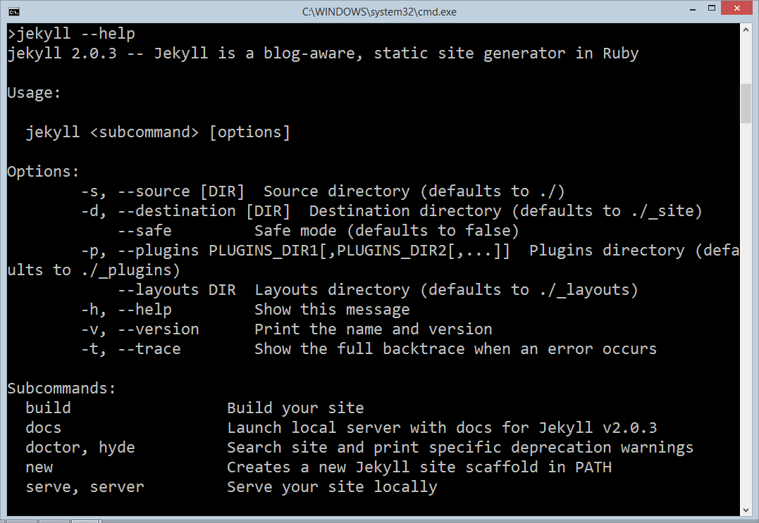
Jekyll in Action
Live Demo

Slide 8
Jekyll
https://softuni.bg/courses/web-fundamentals/

Slide 9
License
This course (slides, examples, demos, videos, homework, etc.) is licensed under the "Creative Commons Attribution-NonCommercial-ShareAlike 4.0 International" license
Attribution: this work may contain portions from
"HTML Basics" course by Telerik Academy under CC-BY-NC-SA license
"CSS Styling" course by Telerik Academy under CC-BY-NC-SA license

Slide 10




Free Trainings @ Software University
Software University Foundation – softuni.org
Software University – High-Quality Education, Profession and Job for Software Developers
softuni.bg
Software University @ Facebook
facebook.com/SoftwareUniversity
Software University @ YouTube
youtube.com/SoftwareUniversity
Software University Forums – forum.softuni.bg

